Slide 1
WELFAKE
[ Word embedding over linguistic features for fake news detection ]

Slide 2
ABSTRACT
Recently, fake news has been incurring many problems to our society. As a result, many researchers have been working on identifying fake news. Most of the fake news detection systems utilize the linguistic feature of the news. However, they have difficulty in sensing highly ambiguous fake news which can be detected only after identifying meaning and latest related information.
To address this issue, we propose a two-phase benchmark model named WELFake based on word embedding (WE) over linguistic features for fake news detection using machine learning classification. The first phase pre-processes the data set and validates the veracity of news content by using linguistic features. The second phase merges the linguistic feature sets with WE and applies voting classification. To validate its approach, this article also carefully designs a novel WELFake data set with approximately 72 000 articles, which incorporates different data sets to generate an unbiased classification output. Experimental results show that the WELFake model categorizes the news in real and fake with a 96.73% which improves the overall accuracy by 1.31% compared to bidirectional encoder representations from transformer (BERT) and 4.25% compared to convolutional neural network (CNN) models. Our frequency based and focused analyzing writing patterns model outperforms predictive-based related works implemented using the Word2vec WE method by up to 1.73%.

Slide 3
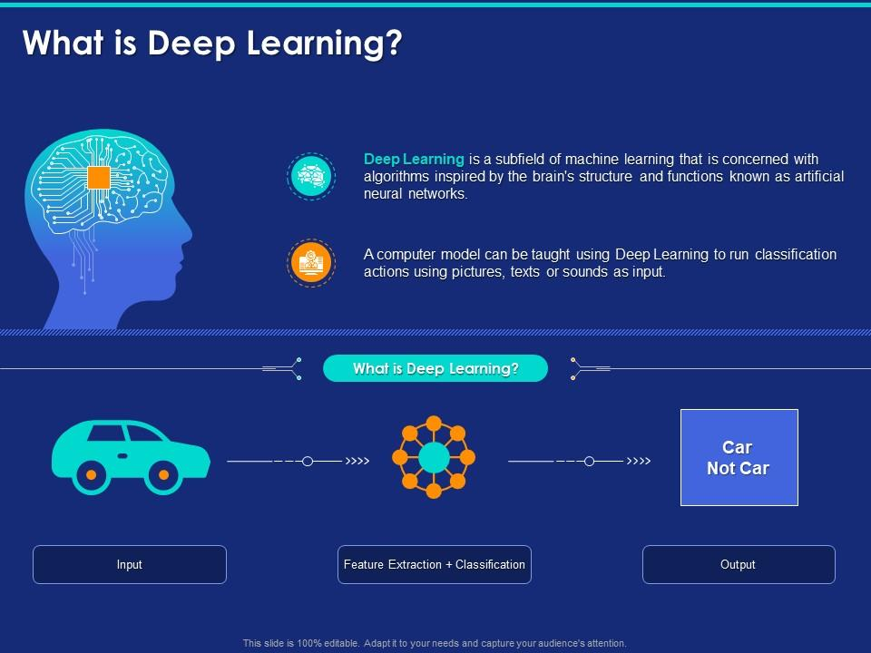
CHAPTER 1
INTRODUCTION
Deep Learning:
Deep learning is a subset of machine learning, which is essentially a neural network with three or more layers. These neural networks attempt to simulate the behavior of the human brain—albeit far from matching its ability—allowing it to “learn” from large amounts of data.

Slide 4
FAKE NEWS: Fake news are low-quality information with purposefully false data, propagated by individuals or bots that deliberately manipulate message for tattle or political plans. Schudson and Zelizer [5] claimed that the term “fake news” originated in previous centuries together with the mass media itself.
Nowadays people around the world are getting much involved on online social networks regardless of age, community, or gender
[1]. Communicating using social networks is simple, fast, and attractive to share and transfer information. Currently, social network sites like Facebook trailed by Twitter are the market pioneers, facilitating over 1.3 billion clients with a dynamic monthly variation of 300 million users in average [
2]. Their collaborations generate Terabytes of information every second [3],
[4]. Online social networks are attractive because of the simple and convenient way to access and circulate information with other people. However, the fast scattering of data at a high rate with minimal effort enables the widespread of false information, such as fake news, which are harmful to society and people.
F

Slide 5
False information categories are fake news, satire, misinformation, rumor, hoax, disinformation, propaganda, and opinion spam . These categories are not mutually exclusive, but many researchers used them with different storylines. Although there exist a few websites to check the authenticity of the news like PolitiFact , The Washington Post Fact Checker , FactCheck , Snopes , TruthOrFiction , FullFact , HoaxSlayer , Vishvas News , Factly Media & Research yet, these websites are unable to spontaneously react to any fake news event.
Fake news examples. (a) Decontextualized news. (b) False news.

Slide 6
2.1 SCOPE OF THE PROJECT
We proposed a novel WELFake model for fake news detection in two steps. 1) collection of various linguistic features from state-of-the- art methods and identification of a subset that performs well on the larger WELFake data set, and 2) ensemble learning on WE features using CNN Model Architecture.
Notes:
6

Slide 7
1.3 OBJECTIVE
This article proposes a two-phase benchmark model named WELFake based on word embedding (WE) over linguistic features for fake news detection using machine learning classification. The first phase preprocesses the data set and validates the veracity of news content by using linguistic features. The second phase merges the linguistic feature sets with CNN Model Architecture. To validate its approach, this article also carefully designs a novel WELFake data set with few articles, which incorporates different data sets to generate an unbiased classification output. Experimental results show that the WELFake model categorizes the news in real and fake and achieved an accuracy of 93%.
Notes:
7

Slide 8
1.4 PROBLEM STATEMENT
However, the following four questions remain unanswered.
1) Which linguistic features are most significant in classifying the news data into real and fake?
2) Which word embedding (WE) technique with linguistic features predicts fake news better than other ML methods like convolutional neural networks (CNNs) or bidirectional encoder representations from transformers (BERTs)?
3) Which classification method is the most appropriate for fake news detection on available data sets?
4) Does ensemble voting classifier improve the fake news detection results?
To answer these questions, we propose a new method called WELFake exclusively focused on text data in three stages.
1) Fake news prediction using linguistic feature sets (LFS);
2) WE over LFS for improved fake news detection over a WELFake data set.
3) Comparative analysis of the linguistic features-based results with state-of-the-art CNN and BERT methods.
The WELFake model does not require additional metadata information related to the user or media [24] for the classification of real and fake news. Instead, it aims for a reformation of the state-of-the-art techniques in the detection of fake news over social media websites by using a combined LFS and WE technique. We highlight three contributions of our WELFake model.
Notes:
8

Slide 9
CHAPTER 2
PROJECT DESCRIPTION
2.1 GENERAL:
We proposed a novel WELFake model for fake news detection in two steps.
1) collection of various linguistic features from state-of-the- art methods and identification of a subset that performs well on the larger WELFake data set, and
2) ensemble learning on WE features using various ML methods.

Slide 10
Word Embedding:
Word embedding represents the density of the word vector. It is a different way to preprocess the data.
This embedding can map semantically similar words. It does not consider the text as a human language but maps the structure of sets of words used in the corpus.
They aim to map words into a geometric space which is called an embedding space. We can use them to make our data a better fit for the TextCNN model

Slide 11
Splitting the dataset:
Split the dataset into train and test. 80% train data and 20% test data.
Building the model:
We use a Convolutional Neural Network (CNN) as they have proven to be successful at document classification problems. A conservative CNN configuration is used with 32 filters (parallel fields for processing words) and a kernel size of 8 with a rectified linear (‘relu’) activation function. This is followed by a pooling layer that reduces the output of the convolutional layer by half.
Next, the 2D output from the CNN part of the model is flattened to one long 2D vector to represent the ‘features’ extracted by the CNN. The back-end of the model is a standard Multilayer Perceptron layers to interpret the CNN features. The output layer uses a sigmoid activation function to output a value between 0 and 1 for the negative and positive sentiment in the review. We can see that the Embedding layer expects documents with a length of 547 words as input and encodes each word in the document as a 11element vector. We use a binary cross entropy loss function because the problem we are learning is a binary classification problem. The efficient Adam implementation of stochastic gradient descent is used and we keep track of accuracy in addition to loss during training. The model is trained for 18 epochs, or 8 passes through the training data. The network configuration and training schedule were found with a little trial and error, but are by no means optimal for this problem.

Slide 12
Analyze and Prediction:
In the actual dataset, we chose only 1 feature:
1. text: comment
2. Labels: Labels
Fake or real.
Apply the model and plot the graphs for accuracy and loss:
We will compile the model and apply it using fit function. The batch size will be 32. Then we will plot the graphs for accuracy and loss. We got average validation accuracy of 99.6% and average training accuracy of 93.3%.
Accuracy on test set:
We got an accuracy of 93.7% on test set

Slide 13
2.3 TECHNIQUE USED OR ALGORITHM USED
PROPOSED TECHNIQUE:
WELFake Model
In this the WELFake model for fake news detection divided into four phases, Data set preparation involves the collection and preprocessing of the data in a proper format, as a fundamental task of any ML model.
Feature engineering involves linguistic feature extraction and selection.
WE identifies the most appropriate technique connected with the LFS.
Fake news detection tunes the model parameters and applies a hard voting classifier for better accuracy.

Slide 14
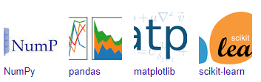
CHAPTER 5
DEVELOPMENT TOOLS
Python
Python is a high-level, interpreted, interactive and object-oriented scripting language. Python is designed to be highly readable. It uses English keywords frequently where as other languages use punctuation, and it has fewer syntactical constructions than other languages.
Libraries used in python:
numpy - mainly useful for its N-dimensional array objects.
pandas - Python data analysis library, including structures such as dataframes.
matplotlib - 2D plotting library producing publication quality figures.
scikit-learn - the machine learning algorithms used for data analysis and data mining tasks.
.

Slide 15
CHAPTER 4
DESIGN ENGINEERING
4.1 GENERAL
Design Engineering deals with the various UML [Unified Modeling language] diagrams for the implementation of project.
Design is a meaningful engineering representation of a thing that is to be built.
Software design is a process through which the requirements are translated into representation of the software. Design is the place where quality is rendered in software engineering.
Design is the means to accurately translate customer requirements into finished product.

Slide 16
4.2 Uml Diagrams
4.2.1 Use Case Diagram
Notes:
The main purpose of a use case diagram is to show what system functions are performed for which actor. Roles of the actors in the system can be depicted. The above diagram consists of user as actor. Each will play a certain role to achieve the concept.
16

Slide 17
4.2.2 Class Diagram
Notes:
In this class diagram represents how the classes with attributes and methods are linked together to perform the verification with security. From the above diagram shown the various classes involved in our project.
17

Slide 18
4.2.4 Sequence Diagram
Notes:
Sequence diagrams are graphical representations of workflows of stepwise activities and actions with support for choice, iteration and concurrency. In the Unified Modeling Language, sequence diagrams can be used to describe the business and operational step-by-step workflows of components in a system. An activity diagram shows the overall flow of control.
18

Slide 19
4.2.8 State Diagram
Notes:
State diagram are a loosely defined diagram to show workflows of stepwise activities and actions, with support for choice, iteration and concurrency. State diagrams require that the system described is composed of a finite number of states; sometimes, this is indeed the case, while at other times this is a reasonable abstraction. Many forms of state diagrams exist, which differ slightly and have different semantics.
19

Slide 20
4.3 System Architecture
Pre-processing and Feature Selection
CNN Model Architecture
Fake news dataset
Predicted Result: Fake news or not
Performance Analysis and Graph
Notes:
20

Slide 21
HARDWARE REQUIREMENTS
Processor - Pentium –IV
Speed - 1.1 GHz
Ram - 256 MB
Hard Disk - 20 GB
Key Board - Standard Windows Keyboard
Mouse - Two or Three Button Mouse
Monitor - SVGA
SOFTWARE REQUIREMENTS
Operating System - Windows XP
Coding Language - Python

Slide 22

CHAPTER 7
SNAPSHOTS
7.1 SNAPSHOTS

Slide 23


Slide 24


Slide 25


Slide 26
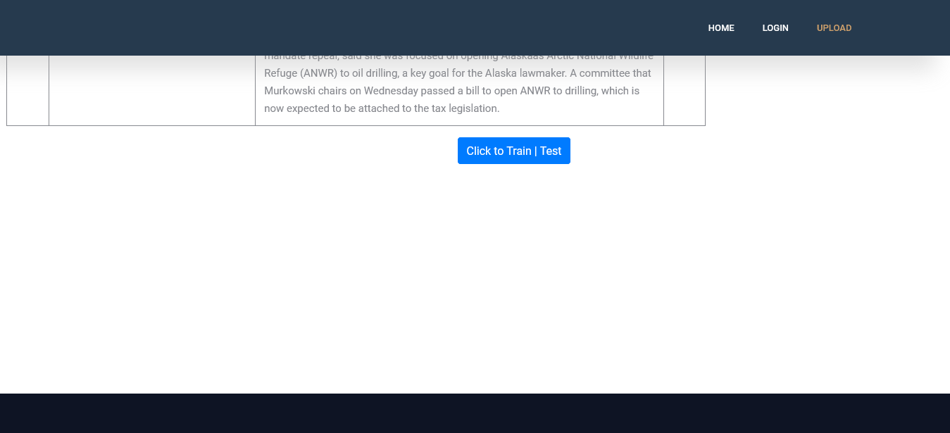

Slide 27
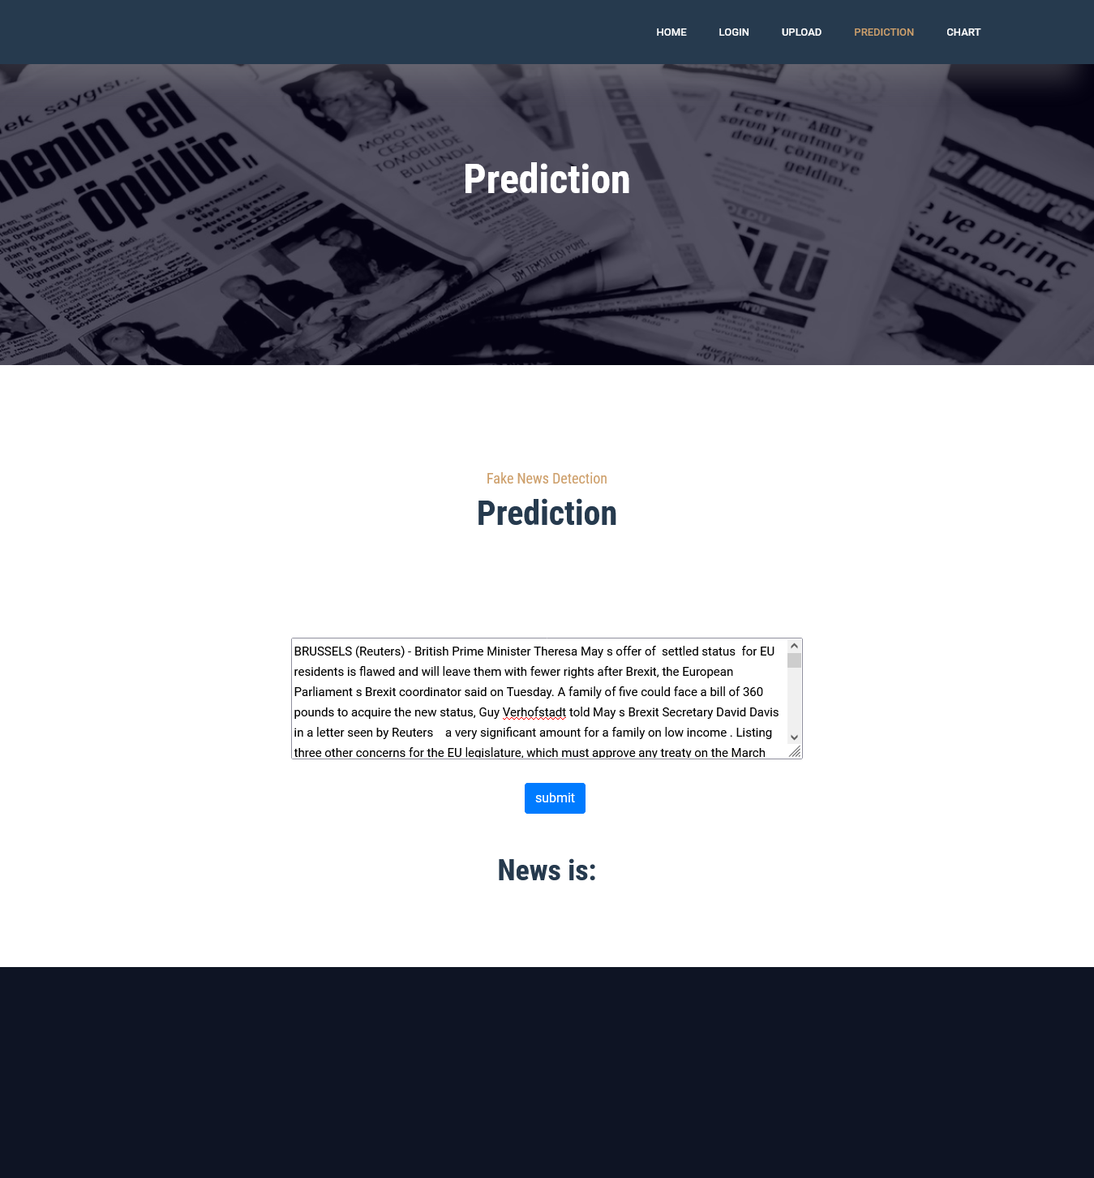

Slide 28
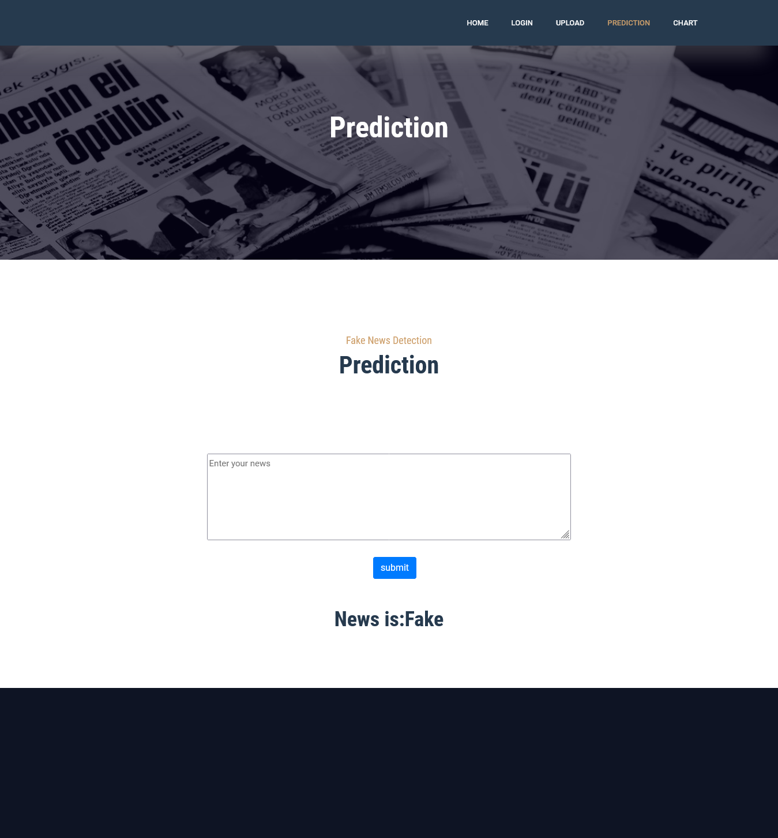

Slide 29
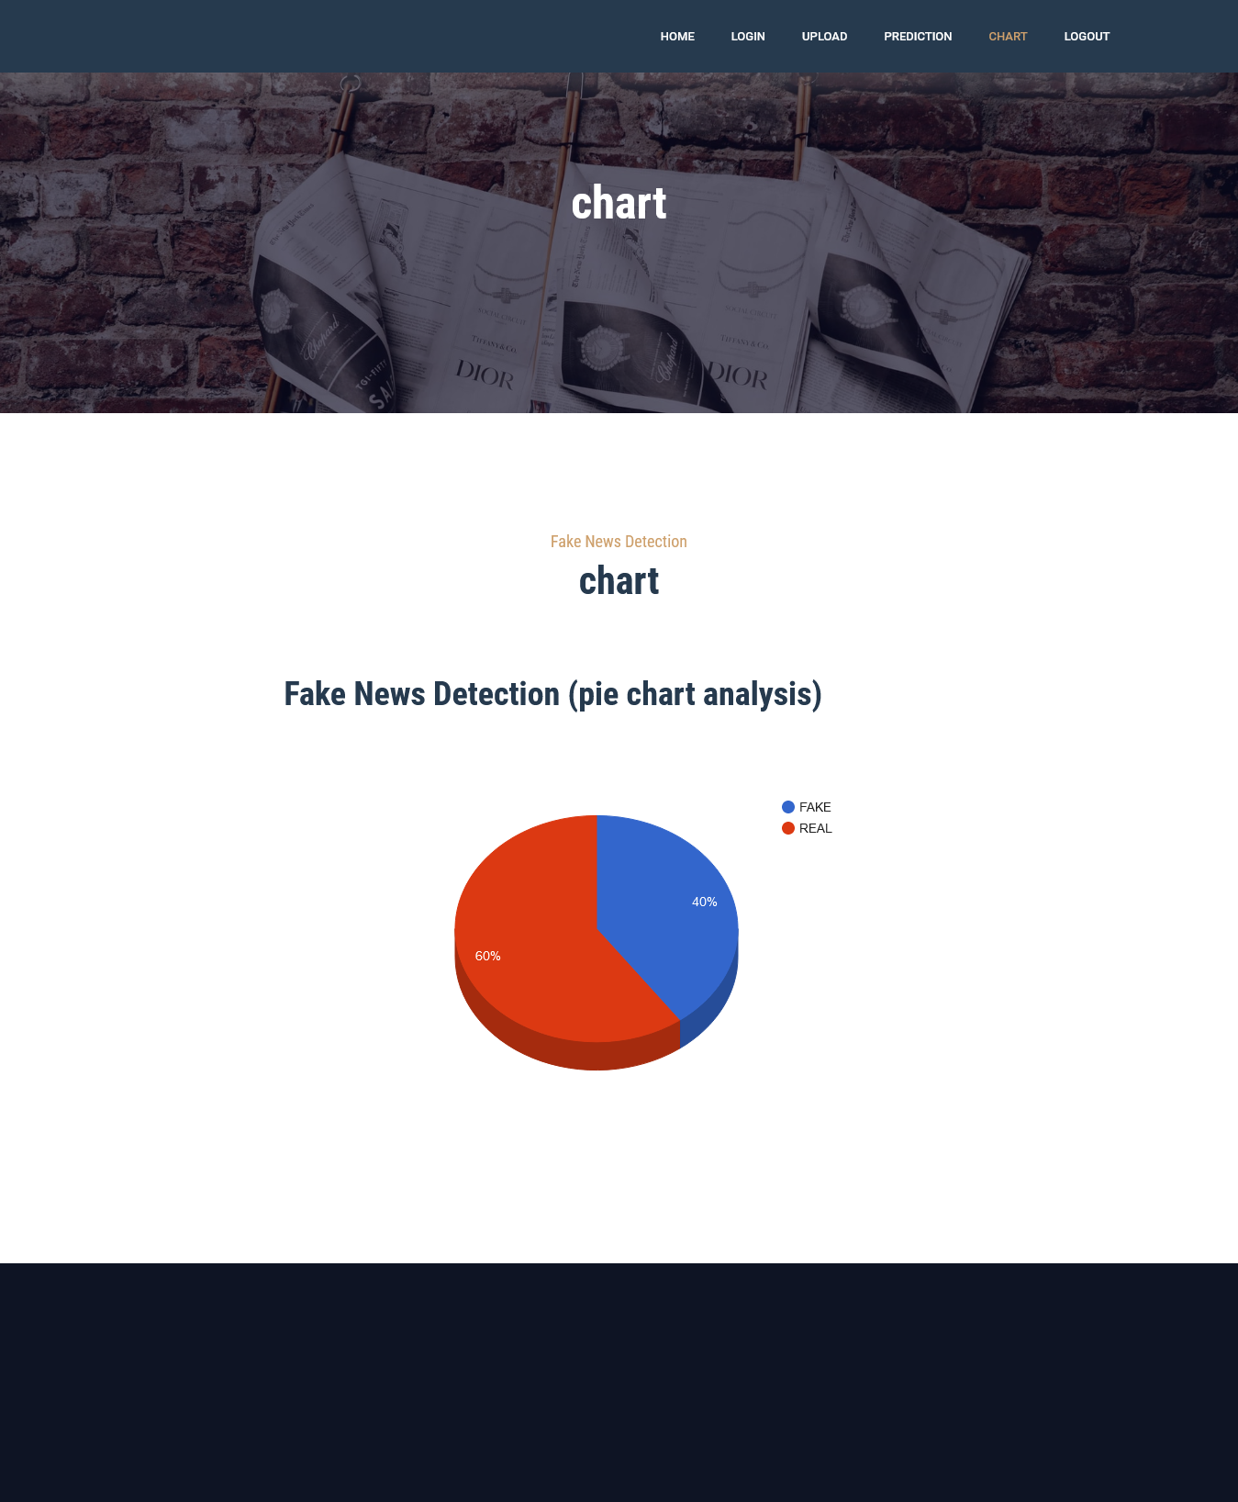

Slide 30
FUTURE ENHANCEMENT
We plan to extend our work in the future with other factors like knowledge graphs and user credibility for further verification of the output generated by the WELFake model.

Slide 31
CHAPTER 10
CONCLUSION
10.1 CONCLUSION
We presented a new model called WELFake for text fake news detection. For this purpose, we prepared a larger data set called WELFake with over news articles combining four open-source data sets (i.e., Kaggle, McIntire, Reuters, and BuzzFeed) to reduce their individual limitation and bias. Afterward, we analyzed inguistic features from state-of-the- art works and increase the standard classifiers’ accuracy. We applied two WE-based methods (i.e., TF-IDF, CV) over these linguistic features using CNN Model Architecture. We finally applied the result of this CNN Model Architecture to the next level with the best model results of TF-IDF and CV over LFS and obtained the final classification. Experimental results show that the WELFake model produces a high 93% accuracy on the WELFake data set. We also analyzed the performance of CNN Model Architecture in terms of accuracy, precision, recall, and F1-score, and found out that CNN Model Architecture produced the most accurate results.

Slide 32
10.2 REFERENCES
[1] W. Jiang, J. Wu, F. Li, G. Wang, and H. Zheng, “Trust evaluation in online social networks using generalized network flow,” IEEE Trans. Comput., vol. 65, no. 3, pp. 952–963, Mar. 2016.
[2] M. Alrubaian, M. Al-Qurishi, A. Alamri, M. Al-Rakhami, M. M. Hassan, and G. Fortino, “Credibility in online social networks: A survey,” IEEE Access, vol. 7, pp. 2828–2855, 2019.
[3] S. Ranganath, S. Wang, X. Hu, J. Tang, and H. Liu, “Facilitating time critical information seeking in social media,” IEEE Trans. Knowl. Data Eng., vol. 29, no. 10, pp. 2197–2209, Oct. 2017.
[4] Z. Zhang, R. Sun, X. Wang, and C. Zhao, “A situational analytic method for user behavior pattern in multimedia social networks,” IEEE Trans. Big Data, vol. 5, no. 4, pp. 520–528, Dec. 2019.
[5] M. Schudson and B. Zelizer, “Fake news in context,” in Understanding and Addressing the Disinformation Ecosystem. Philadelphia, PA, USA: Annenberg School for Communication, Apr. 2017, pp. 1–4.
[6] S. Zaryan, “Truth and trust: How audiences are making sense of fake news,” M.S. thesis, Media Commun. Studies, Lund Univ. Publications Student Papers, Stockholm, Sweden, Jun. 2017. [Online]. Available: https://lup.lub.lu.se/student-papers/search/publication/8906886
[7] S. Vosoughi, D. Roy, and S. Aral, “The spread of true and false news online,” Science, vol. 359, no. 6380, pp. 1146–1151, Mar. 2018.
[8] R. Sequeira, A. Gayen, N. Ganguly, S. K. Dandapat, and J. Chandra, “A large-scale study of the Twitter follower network to characterize the spread of prescription drug abuse tweets,” IEEE Trans. Comput. Social Syst., vol. 6, no. 6, pp. 1232–1244, Dec. 2019.
[9] Politifact News Dataset. Accessed: Mar. 31, 2020. [Online]. Available: http://www.politifact.com/
[10] The Washingtonpost Fact Checker. Accessed: Mar. 31, 2020. [Online]. Available: https://www.washingtonpost.com/news/fact-checker

